Slide 1

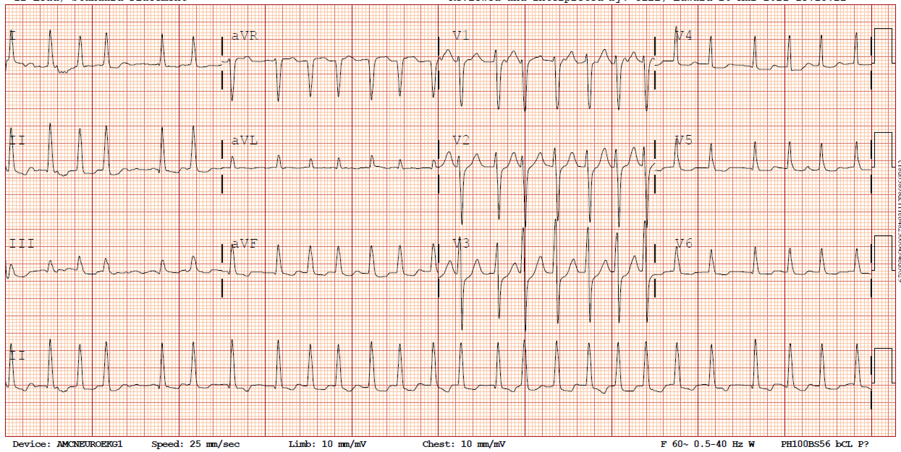
68 yo M with hx of HTN, DMII and COPD who presents with dyspnea on exertion and palpitations.
Pathophysiology
Work-up
Management
Cases
Narrow QRS (<120 ms)
ATRIAL FIBRILLATION WITH RAPID VENTRICULAR RATE
DIAGNOSIS
Irregularly irregular ventricular rate > 100 bpm
No discernible P waves

Slide 2
PATHOPHYSIOLOGY
Pathophysiology
Work-up
Management
Click anywhere to continue
Cases
Multiple micro-reentry circuits
Atrial rate of ~400 bpm
SA
AV
Ventricular rate is determined by AV node refractory period

Slide 3
WORK-UP
Pathophysiology
Work-up
Management
Cases
Cardiac
SA
Valvular heart disease
TTE
AV
Structural heart disease
Decompensated HF
± BNP
New ischemia
ECG ± troponin
Non-cardiac
TTE, ± CXR,
± OSA screen
Pulmonary disease
Drugs/ toxins
± urine tox screen, ETOH level
Metabolic
BMP + Mg, CBC
Endocrinopathies
TSH + reflex T4

Slide 4

MANAGEMENT
Pathophysiology
1
UNSTABLE?
Work-up
Management
Sustained hypotension (SBP < 90)
SBP ↓ >30 mmHg + CP/AMS/SOB
Cases
SA
IV 5 mg q5min x 3
PO 12.5-37.5 mg q6h
Caution in decomp HFrEF, sepsis
AV
Metoprolol
↓↓
BP
Yes
2
No
Amio
Sedation
DCCV 120-200J
Anticoagulation
Rate control
BB
Digoxin
IV 10-20 mg bolus + drip
PO 30-90 mg q6h
Diltiazem
↓↓
BP
Caution in HFrEF, sepsis
CCB
+
IV 0.25-0.5 mg → 0.25 mg IV q6h x 2
Caution in elderly, renal failure
Inotropy
Digoxin
↔
ACUTE
HR < 130
HR > 130
Oral meds
HR goal <110
IV meds
CHRONIC
Amiodarone
IV 150 mg bolus then drip
↓
BP
Caution in chronic AF

Slide 5
Case 1
Case 2
Case 4
Pathophysiology
Work-up
68 yo M with hx of HTN and DMII presents with new onset AF with RVR, HR of 160s. BPs are 120s/60s. He reports dyspnea and palpitations.
54 yo F with HTN and ETOH use disorder is admitted for septic shock on vasopressors. You are called for new onset AF with HRs in the 150s. MAPs are 70s on 0.1 of norepinephrine.
72 yo M with DMII, HTN, and HFrEF (25%) presents with AF with RVR with HRs of 160s. BPs 110s/60s. He denies orthopnea, PND.
Management
Cases
How would you manage this patient?
He has stable AF with RVR.
With HRs > 130, give IV metoprolol 5 mg or IV diltiazem 10 mg.
Work-up: CBC, BMP/Mg, TSH, ECG, Troponin, CXR
How would you manage this patient?
Despite being on vasopressors, this patient is in stable AF with RVR. Given septic shock, amiodarone > metoprolol or diltiazem.
How would you manage this patient?
He has stable AF with RVR. Given HFrEF, he should not receive CCBs. Β-blockers can be used in compensated HFrEF. Give IV metoprolol 5 mg.
He receives IV metoprolol 5 mg and his HRs improve to 140s. BPs are 110/70s.
He receives IV metoprolol 5 mg x 3 and his HRs improve to 140s. BPs are 90/60s. He reports palpitations, but no chest pain, dyspnea, or altered mentation. BMP is normal. Urine output is adequate.
Case 3
His HRs remain > 130s with stable BPs. Give another dose IV metoprolol 5 mg.
How would you manage this patient?
68 yo M with AF with RVR currently on an esmolol drip in the ICU. You are called for HRs in the 160s, BPs that dropped to 85/palp, and the patient is unresponsive.
He receives IV metoprolol 5 mg and his HRs improve to 120s. BPs are 100/70s.
How would you manage this patient?
He remains stable but has low BPs from IV metoprolol. Digoxin is the only BP neutral medication and has positive inotropy and should be used as your next agent.
Give an IV load of 0.25 – 0.5 mg digoxin.
How would you manage this patient?
His HRs are now < 130, transition to PO metoprolol 12.5 – 25 mg q6h.
His CHADS-VASc is 3, consider anticoagulation.
This patient is unstable! Place pads and prepare for DCCV with 120-200 J.
All cardioverted patients should receive anticoagulation.
How would you manage this patient?

Slide 6
2023 ACC/AHA/ACCP/HRS — Currency Note
• Acute rate-control teaching is unchanged: BB or non-DHP CCB first-line; digoxin and amiodarone second-line; lenient resting HR <110 is acceptable when asymptomatic with preserved LVEF (RACE II).
• Avoid non-DHP CCBs (diltiazem/verapamil) in HFrEF — use a β-blocker once compensated; amiodarone or digoxin if BP-limited (as in the deck's cases).
• Unstable AF (hypotension, ischemia, AMS, shock) → synchronized DCCV without delay — unchanged.
• Cardioversion + anticoagulation: if AF ≥48 h or unknown duration, ≥3 wk therapeutic anticoagulation before, OR a TEE to exclude thrombus; then ≥4 wk after regardless of CHA₂DS₂-VASc. Long-term stroke prophylaxis by CHA₂DS₂-VASc (2023 ACC); the 2024 ESC uses CHA₂DS₂-VA (drops the sex category).
Source: 2023 ACC/AHA/ACCP/HRS AF Guideline (Circulation 2024); ESC 2024 AF Guideline.

Slide 7
Take-Home Points
• AF with RVR on ECG = irregularly irregular, narrow QRS (<120 ms), no discernible P waves, ventricular rate >100.
• Work up new AF for cardiac and non-cardiac triggers: TTE, BMP+Mg, CBC, TSH, ECG ± troponin; add CXR / OSA / tox / EtOH per the story.
• First decide stability: unstable (SBP <90, or SBP drop >30 with CP/AMS/SOB) → synchronized DCCV 120–200 J; don't let sedation delay it.
• If stable, rate-control to HR <110: IV agents if HR >130, oral if 110–130. BB and CCB are first-line; avoid CCB in HFrEF; digoxin is the BP-neutral choice; amiodarone favored in shock.
• Anticoagulate anyone cardioverted (≥4 wk after) and guide long-term therapy by CHA₂DS₂-VASc.

Slide 8
Attribution & Optimization Notes
• Original: "Management of Atrial Fibrillation with Rapid Ventricular Response," TeachIM.org — Buchanan C, Prouse A, Zhang Y. Published April 2021.
• Source URL: teachim.org/teaching_material/management-of-atrial-fibrillation-with-rapid-ventricular-response/
• License: Creative Commons Attribution-NonCommercial 4.0 International (CC BY-NC 4.0). Educational use only; not medical advice.
• Correction (this copy + learner board): drug-class label "CBB" → "CCB" (calcium channel blocker) on the Management slide — "CCB" is used correctly elsewhere in the same deck.
• Added context: 2023 ACC/AHA/ACCP/HRS currency note (rate-control targets/agents unchanged; cardioversion anticoagulation rule; CHA₂DS₂-VASc vs ESC 2024 CHA₂DS₂-VA). Original animated slides preserved; content appended only.
• Teaching (presenter) board optimized here; learner board included as a companion (same CBB→CCB fix). Optimized 2026-06-10. Clinician-review before teaching.

